Slide 1
Introduction to Hardware Attacks
Josh Rabinowitz

Slide 2
Agenda
Day 1– Introduction
Day 2– Board & Components
Day 3– External Interfaces I
Day 4– External Interfaces II
Day 5– Conclusion

Slide 3
Day 1

Slide 4
Introduction

Slide 5
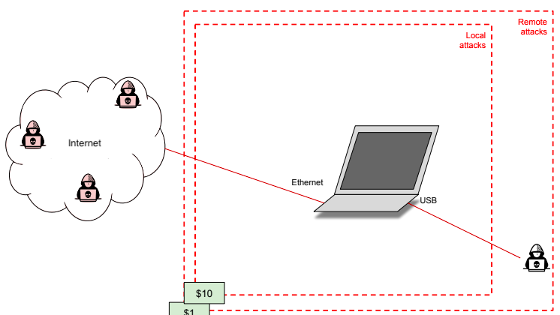
Why Hardware Security?
Consider your attack surface…

Slide 6
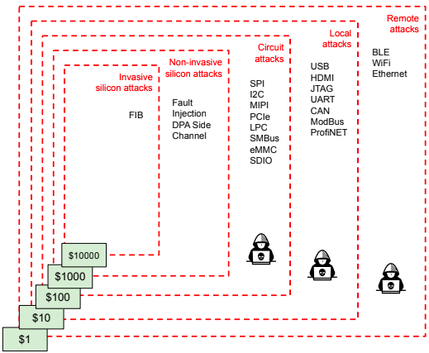
Why Hardware Security?
Consider your attack surface…

Slide 7
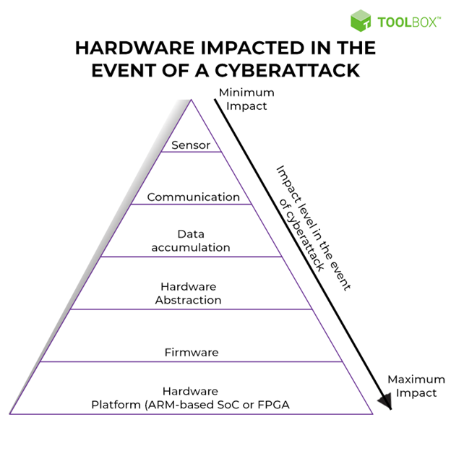
Why Hardware Security?
Consider your impact…

Slide 8
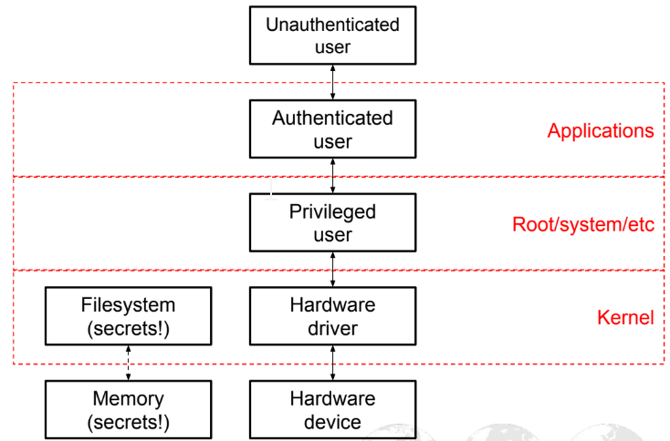
Why Hardware Security?
Consider attack routes and effort…

Slide 9
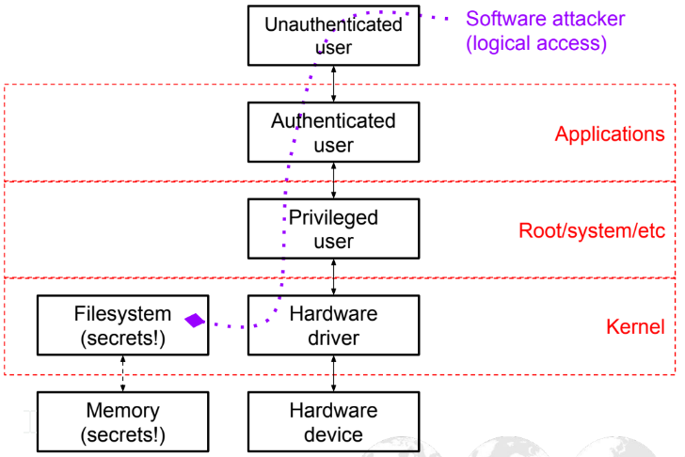
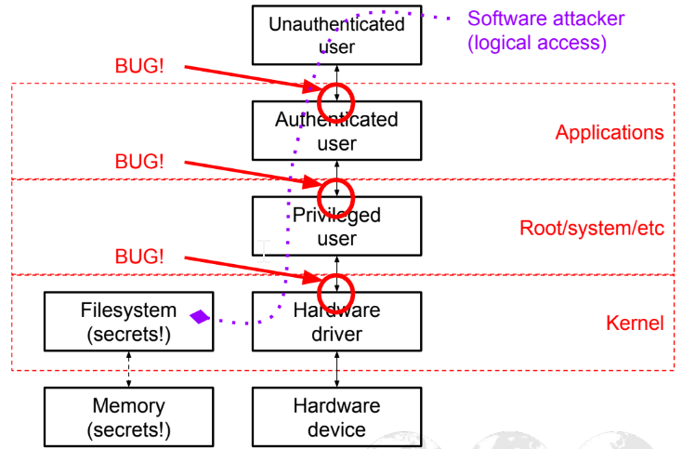
Why Hardware Security?
Consider attack routes and effort…

Slide 10
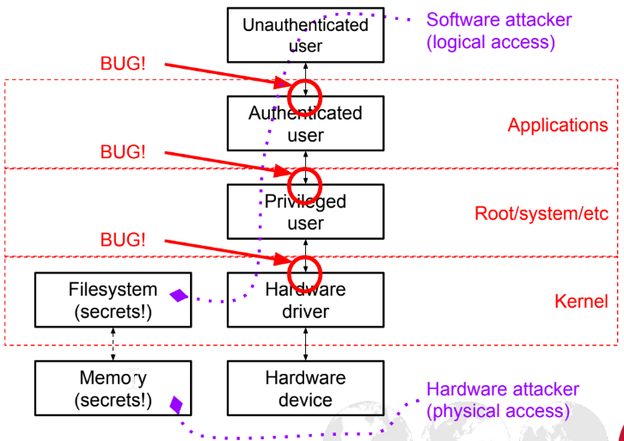
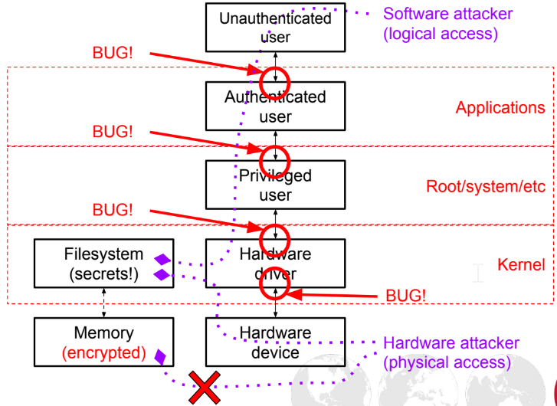
Why Hardware Security?
Consider attack routes and effort…

Slide 11
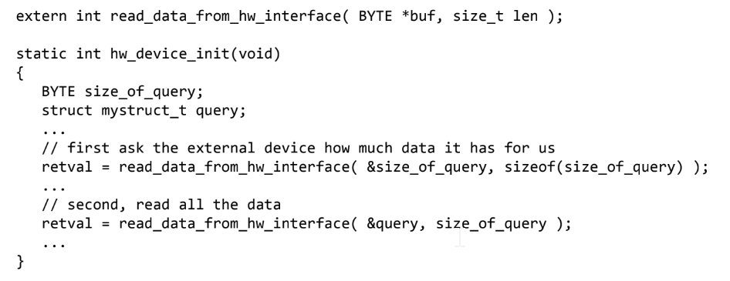
Example
(ACTUAL) Hardware driver bug – can you spot the problem?

Slide 12
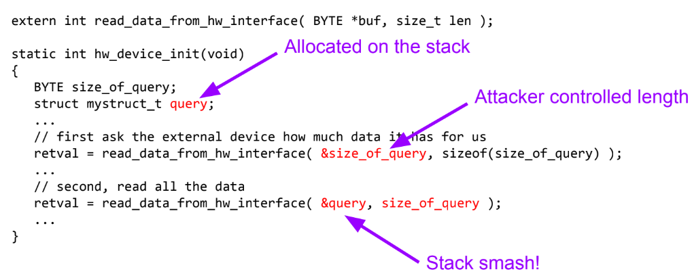
Example

Slide 13
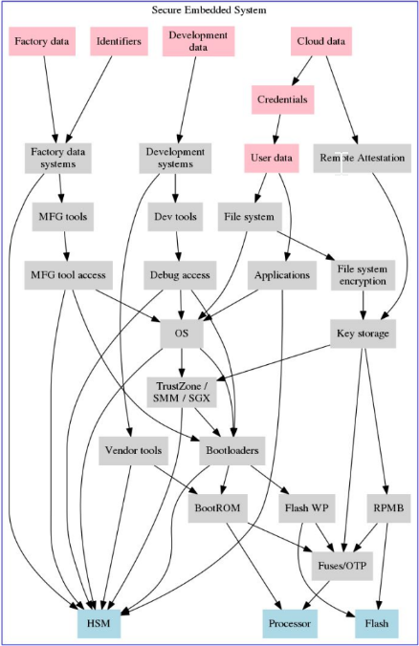
Secure Hardware Design
Upper layers protected by lower layers
Layers of trust
Code signing
Exploit mitigations
Cert pinning, encryption
Write protections
Access controls
MFA
Root of trust/Anchor
Baked into silicon
Unique to device
Unknown to vendor
Strong key management

Slide 14
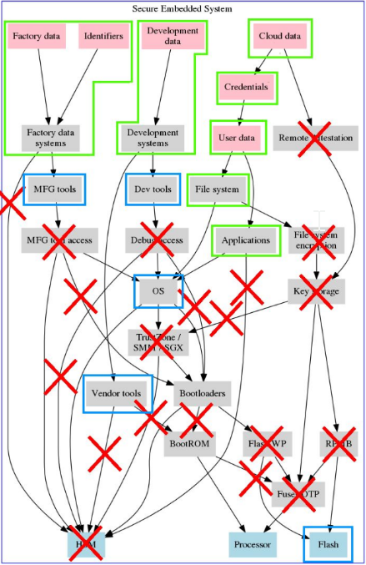
ACTUAL Hardware Design…
Chains of trust rarely extend below OS
Absent code signing
Vulnerable supply chains
Wide open debug access
Leaked/unprotected MFG tools
Direct access to filesystems

Slide 15

ACTUAL Hardware Design…
HW security ~15yrs behind SW security
Fewer attackers, mostly due to equipment costs
MOST consumer electronics are “fish in a barrel” to the skilled attacker
This is improving as tools grow cheaper and more accessible at hobbyist level…

Slide 16

Embedded Systems
Definition: “An embedded system is a system that has a software embedded into computer-hardware which makes a system dedicated for an applications or specific part of an application, product or part of a larger system.”
Device includes programable CPU, not intended as general-purpose computer
(Essentially: Computers that don’t LOOK like computers!!)

Slide 17
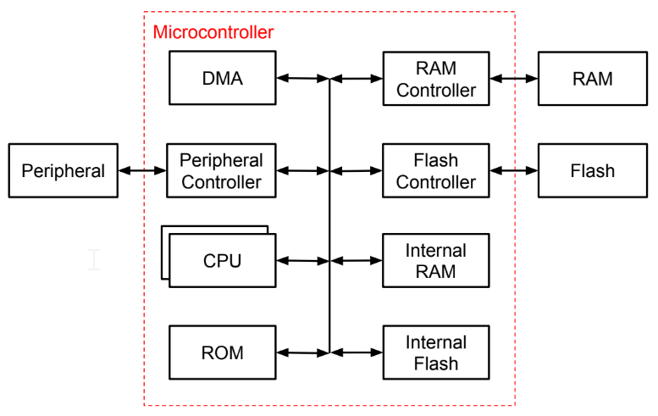
Embedded Device Architecture

Slide 18

Finding Bugs
Reading specs
Design bugs found by careful read
Reading errata
Implementation bugs, reported w/workarounds
Often have undocumented security impact
Fuzzing external interfaces
Anything w/protocol → potential SW bugs
Glitching & Fault Injection
Manipulating power/clocks
Localized failures induced w/lasers
Invasive circuit/silicon modification
Bypass protection circuits
Internal data bus taps

Slide 19
Finding Secrets
What are we after?
User Data
Passwords, emails, documents, photos, contacts, etc.
Software
1st step to RE is obtaining a copy
Intellectual Property
Counterfeiting
Industrial espionage
Competitive Analysis
Network Access
Pivot from device to other nodes
Gaining persistence
Surveillance
Control sensors (camera, mic, GPS, accelerometer, etc.)

Slide 20
Finding Secrets
What do we look?
Common storage
Volatile
DRAM/DDR/LPDDR
SRAM
Registers
Persistent (on-chip, off-chip, removable)
Flash
EEPROM
EPROM
OTP/Fuses
ROM
Cloud (not HW but may obtain credentials!)

Slide 21
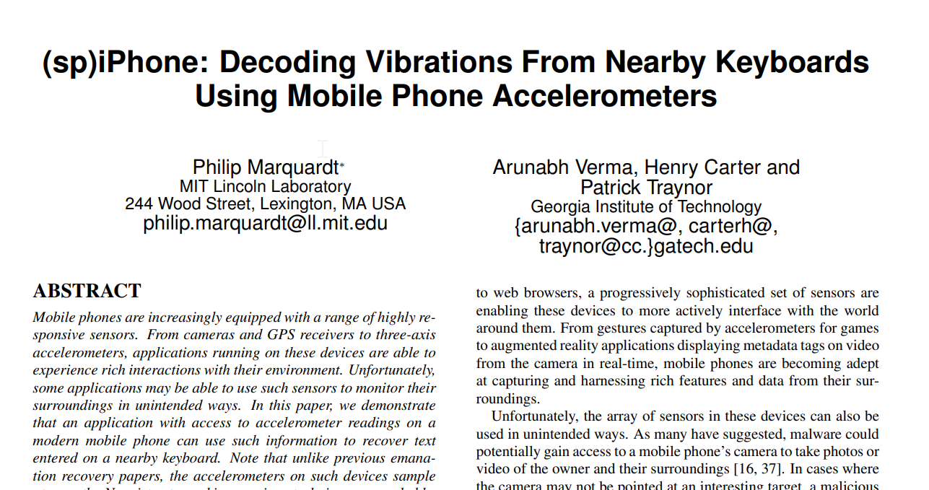
Common Findings
Memory
Unencrypted memories
Accessible signals
Secure Boot
Incomplete chain-of-trust
TOCTOU
Partial signing
Fail open
Defenses reliant on untrusted data
Boot mode pins
Flags in flash memory
Debug access
JTAG, UART, test points
Privileged modes
Privacy controls
Equivalence of sensors ☺

Slide 22

Time-bound Assessments
Areas of focus:
Secure-boot chain
Boot-time firmware validation
Firmware update
Bypass secure boot?
Storage
Extract sensitive assets
Inject malicious code/data
Attackable interfaces
Start w/most external/privileged
network, USB, debug
New/proprietary/complex drivers
Things to skip:
Well-researched components
Hard to reach/unprivileged code
Unrealistic threats
Vendor code (Linux, AOSP, libs)
DO check known issues!
Outdated code/libs
CVE’s
Certain ‘insecure’ vendors (Mediatek, Synaptics, etc.)

Slide 23
Case Study: Device Overview

Slide 24
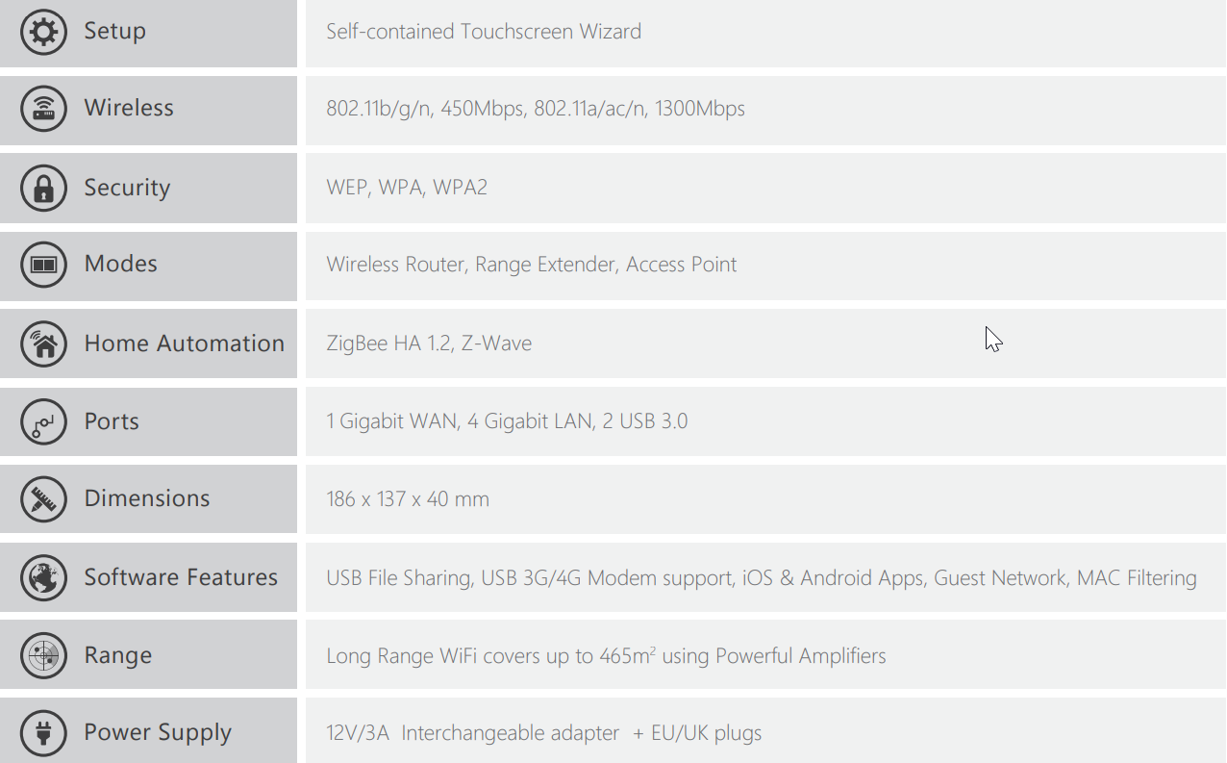
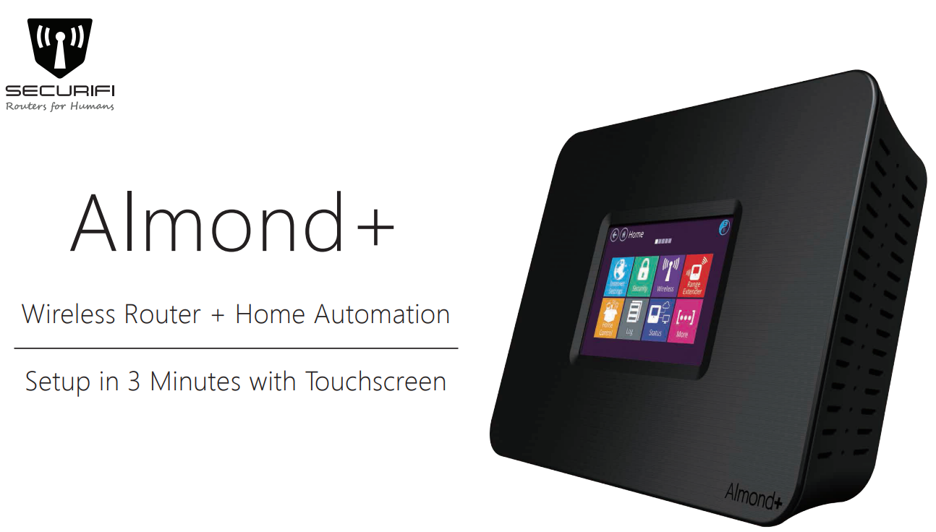
The Almond+ Router
Securifi Almond+
https://www.securifi.com/rg/almondplus
https://www.amazon.com/Securifi-Almond-Touchscreen-Wireless-Automation/dp/B00R0C2U5E

Slide 25
Case Study: Setup

Slide 26
“3-Minute Setup”
More like ~20 minutes…
Once setup/connected:
Create user data
Explore (attackable) functionality
Do this before tearing open!

Slide 27
Case Study: Teardown

Slide 28
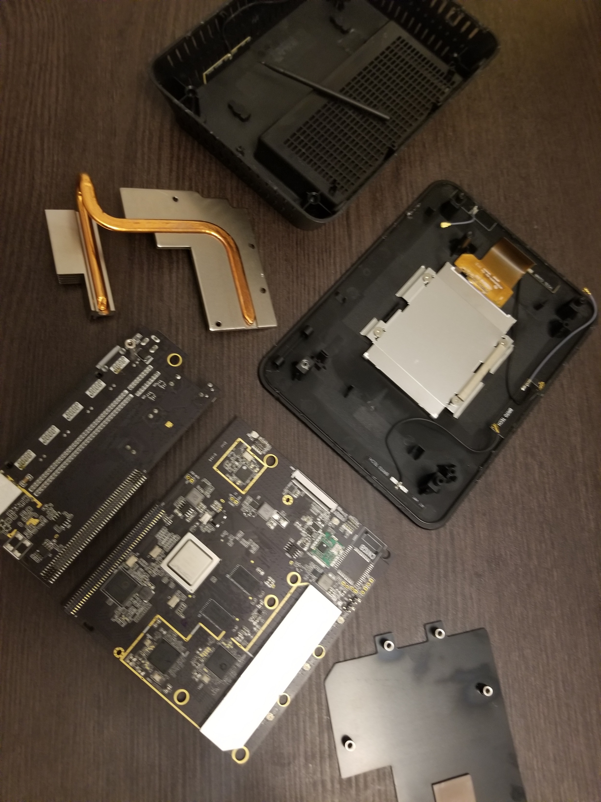
Quick step – expose the board WITHOUT doing damage
Be careful with antennas, display connector

Slide 29
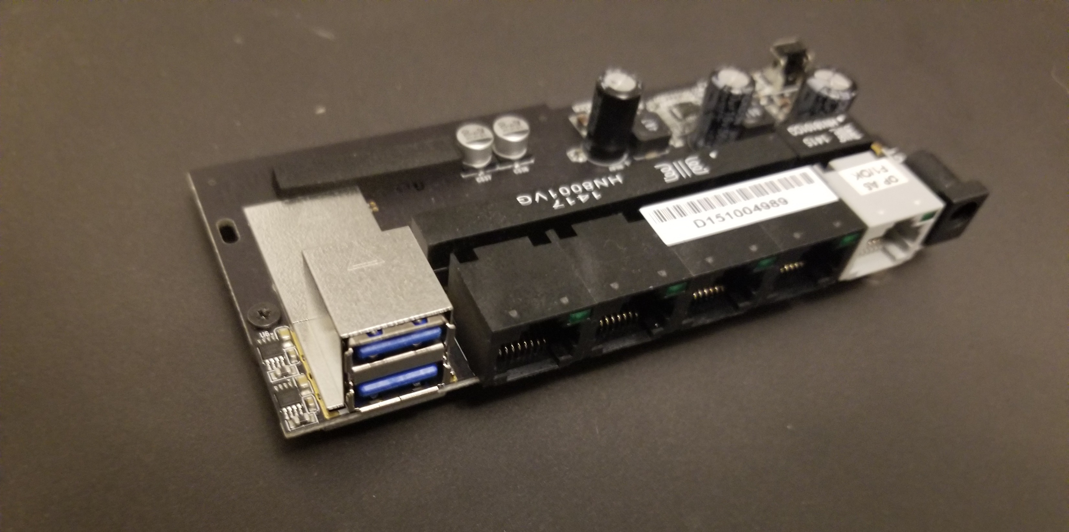
Keep this module handy, we’ll need it to power the main board!

Slide 30
Day 2

Slide 31
The PCB – At a Glance

Slide 32
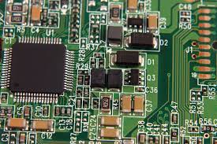
Basic Circuitry
Resistors
Capacitors
Diodes/Triodes
Inductors
Transistors
Oscillators
Buttons/Switches

Slide 33
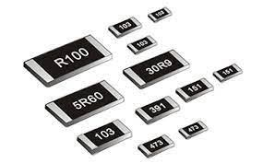
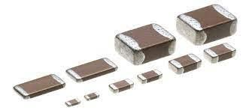
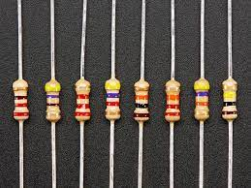
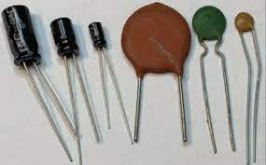
Recognizing Through-Hole vs Surface Mount
Components are fixed to a PCB using either plated “through-holes” (PTH/THT) or surface mount design (SMD/SMT)
Note that PTH and SMD components will look different
Images on the left are all resistors, on the right capacitors
Images on top are for SMD, bottom are for PTH
Useful resource for recognizing SMD components:
https://www.pcbonline.com/blog/how-to-identify-smd-components.html
As we’ll see later, this concept applies to connectors and hardware interfaces in addition to components

Slide 34
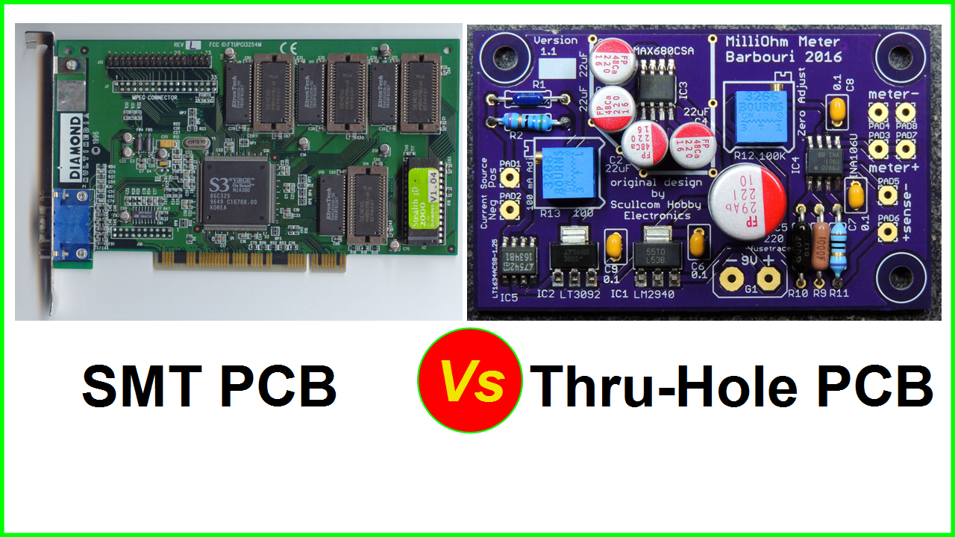
Through-hole vs. Surface Mount - Example

Slide 35
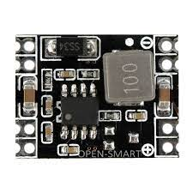
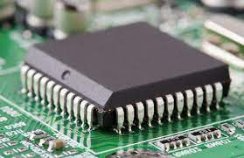
Integrated Circuits
Analog
Regulators
Op-Amps
A-D Converters
RF IC’s
Temp Sensors
Digital
CPU’s, MCU’s, SoC’s
Communication/Management IC’s
Memory

Slide 36
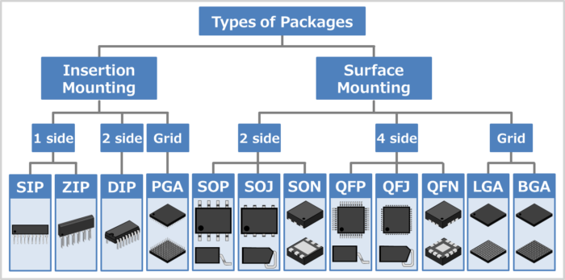
Integrated Circuits - Packages
Package types are classified in various ways:
Through-hole vs SMD
Shape – e.g. rectangular, square, linear
Size/thickness
Pin count
Note: not all package types/names are shown above…there are MANY more!

Slide 37
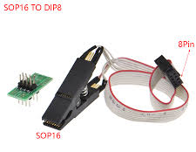
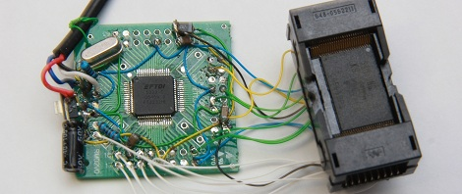
Integrated Circuits - Packages
As an attacker, the package type alone provides some help:
With experience, an attacker may deduce a chip’s function based on package type
Package will determine what tools we can use to interface with the chip
Chip-On vs. Chip-Off
Chip-clip. Pin-clips, socket, etc.
Some IC’s come in more than 1 package type, and share a datasheet– we’ll need to identify the appropriate version to obtain the right pinout

Slide 38
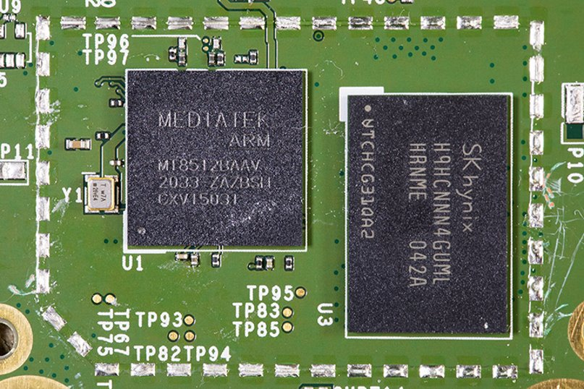
Integrated Circuits – Packages
Example 1: BGA
As there are no ‘legs’ (pins) protruding visibly from the IC’s pictured here, we can deduce they use Ball Grid Arrays
They’ll need to be removed before we can interface or determine the pinout
Commercial socket/reader is the ideal tool, as “deadbugging” (soldering to individual pins) would require unreasonable effort

Slide 39
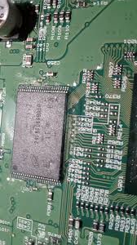
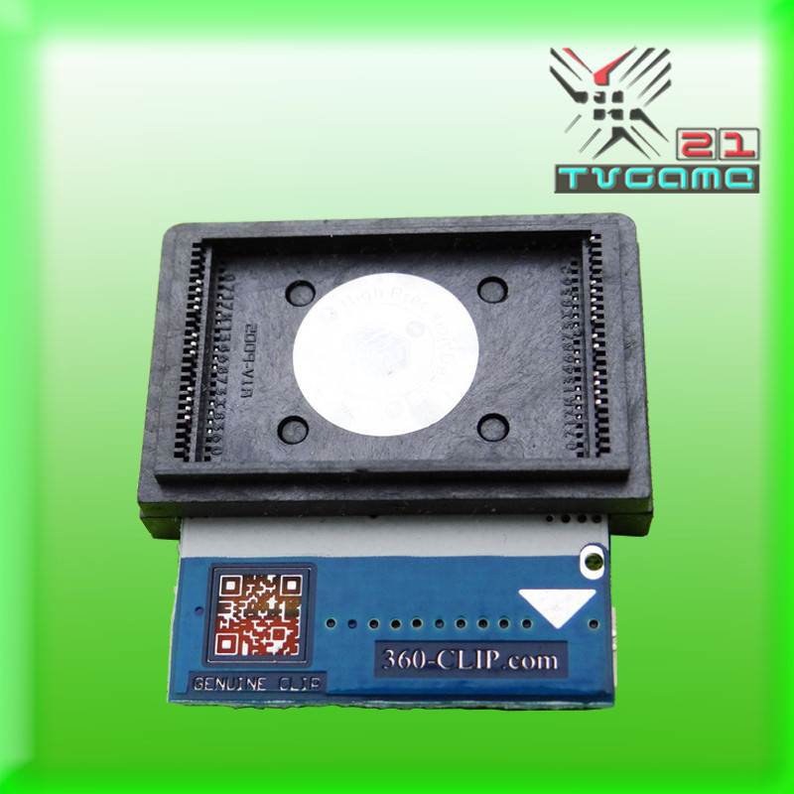
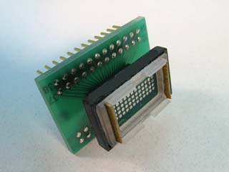
Integrated Circuits – Packages
Example 2: TSOP-48
This IC is packaged as a Thin Small Outline Package with a total of 48 pins – a common package for NAND flash chips
Standard test clamps (“chip-clips”) are not widely available for this package…
Some Chip-On solutions:
Xbox “360 Clip”
https://360-clip.com/
Delta Probe
https://www.adapt-plus.com/products_html/8800-0150.html

Slide 40
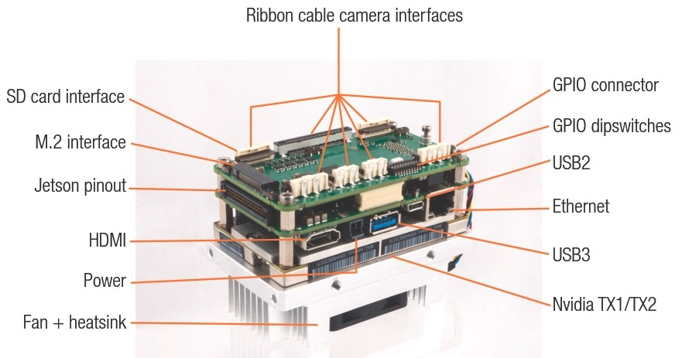
Common Ports & Interfaces

Slide 41
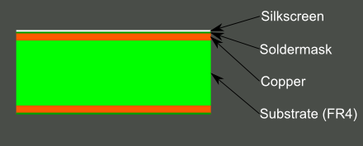
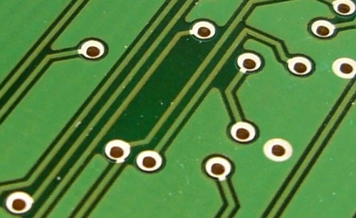
The PCB Itself
In addition to the board’s components, we can study the board itself to learn more
Traces – can we determine how the board’s components are connected?
Via’s – may allow us to trace routes between layers
Ground layer– without a GND pin, we can use this layer as a reference when probing the board

Slide 42
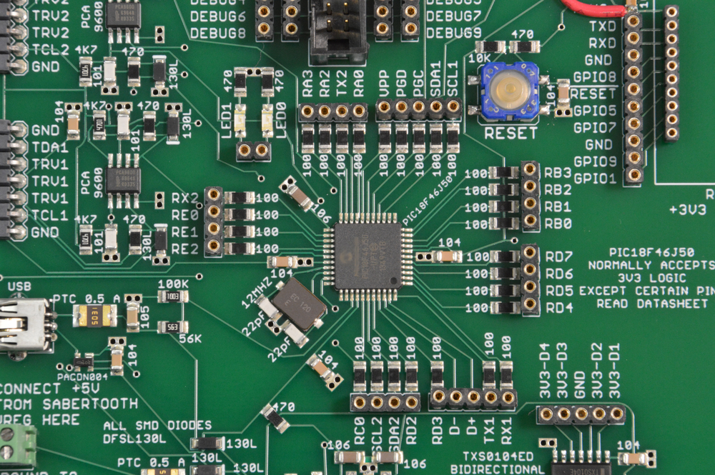
The PCB Itself – Silkscreen
Layer of ink which may contain:
Safety/regulatory markings
Component symbols
Placement markers
Pin indicators
Logo’s, branding
May ease assembly/manufacturing, improve appearance, or provide user clarity

Slide 43
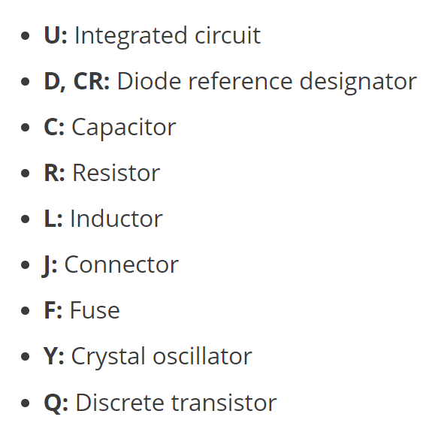
The PCB Itself – Silkscreen
Silkscreen symbols for components, known as reference designators, are of particular interest to an attacker
There are 2 standards which outline reference designators for various components, including:
IEEE 315-1975
ASME Y14.44-2008

Slide 44
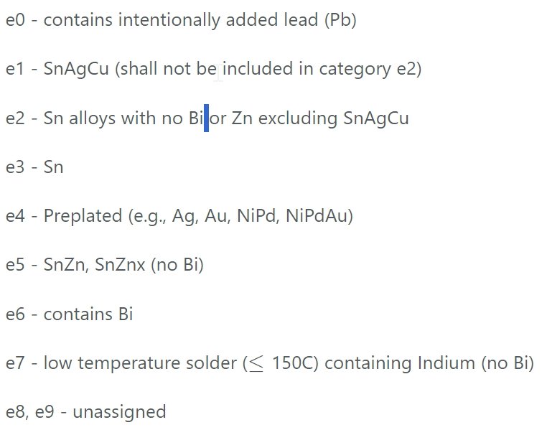
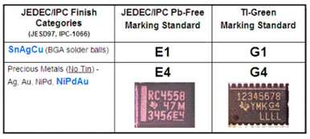
The PCB Itself – Silkscreen
Knowing which markings and symbols are useless to the attacker will save precious time
For instance:
https://www.ipc.org/system/files/technical_resource/E7%26S22_02.pdf
Various standards exist for marking materials/finish
Seen on both chips and PCB’s
Untrained eye may confuse these for component symbols, chip numbers, etc.

Slide 45
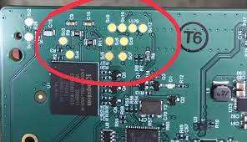
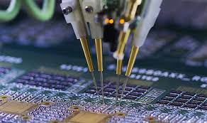
The PCB Itself – Test Points
Most manufactured PCB’s are littered with small copper pads. These are used during production to probe the board’s circuitry and monitor/inject test signals (using bed-of-nails or flying probe machines)
Most test points are useless to an attacker; however, as we’ll explore later, they sometimes provide hidden access to a critical interface (JTAG, UART, etc.)
Additionally, probing with a multimeter may tell us about the board’s Logic-Levels

Slide 46
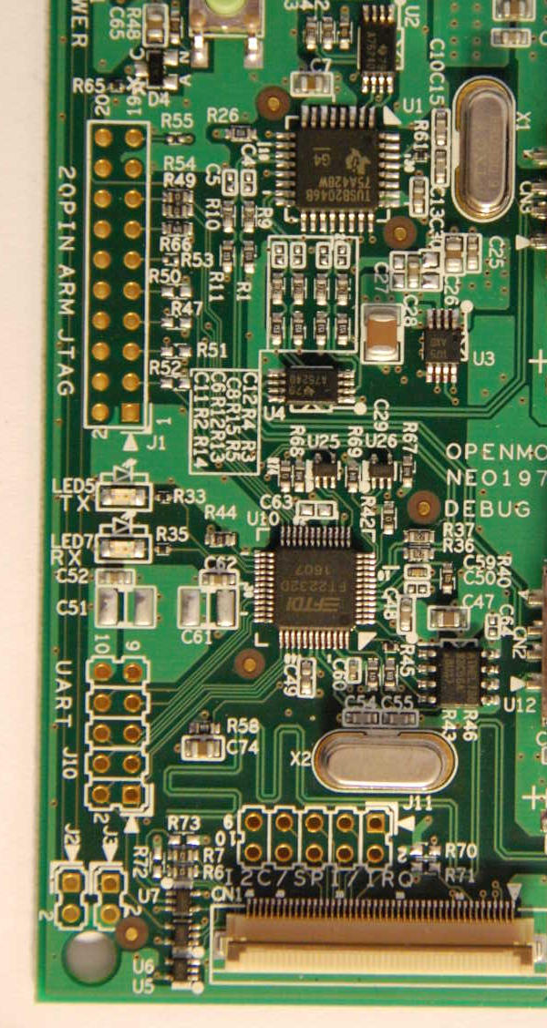
The PCB Itself – Ports/Headers
In addition to scattered test points, a PCB may contain ports, headers, and other standard breakouts for physical connection
Chips themselves utilize “external interfaces” for communication, debugging, flashing, etc.
Ports/headers provide easy outside access without removing chips or modifying circuitry
As an attacker, these are of significant interest as they may provide direct routes for attack
We’ll explore the most common external interfaces and how to approach them in later sections

Slide 47

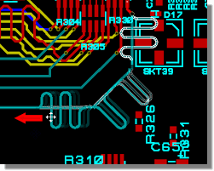
The PCB Itself – Other Concepts
Length Matching
For high-speed applications, small timing mismatch can prevent proper wired communication (especially for synchronous protocols)
To prevent mismatched signals, length-matching may be used when routing traces
An attacker should spot the use of convoluted traces which may hint at an attack path

Slide 48
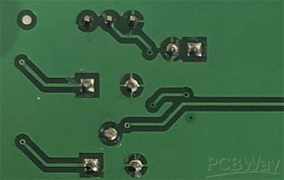
The PCB Itself – Other Concepts
Trace Width
PCB traces either carry signals or power; as power traces require more current, power traces are typically wider than signal traces
Pad Shapes
A grounded (GND) pad can be spotted by the crosshair shape in the soldermask
A squared pad juxtaposed by circular pads usually indicates a power (Vcc) pad

Slide 49
Secure PCB Design
As we’ve seen, an experienced attacker may simply glance at the exposed PCB and glean information such as:
Primary components
Basic architecture and operation
I/O Capabilities, Storage, Power
External Interfaces
Required attack tools
Plausible attack paths
In many cases, a security-conscious designer can make simple modifications to discourage or slow down attackers at this starting phase

Slide 50
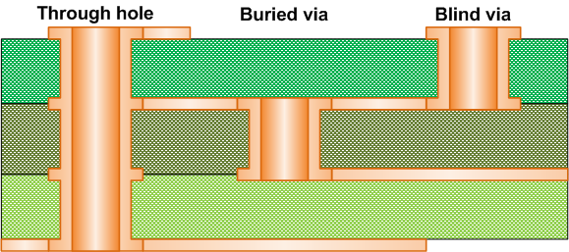
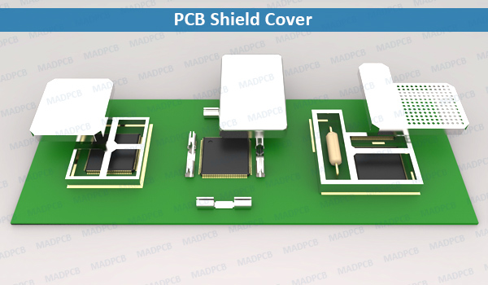
Secure PCB Design
Heavy Layering; Blind/Buried Via’s
Buried Traces
No Silkscreen/symbols
Removed/disabled components
Missing pull-up/pull-down resistors
Severed traces
Shielded/covered circuitry
Unpopulated connectors
Sanded chip #’s

Slide 51
Exercise – Spot the difference(s)
The following slide contains images of:
An older SSD from Intel (left)
A recent SSD from Intel (right)
Can you point out 2 design changes Intel has made over the years to make their drive more secure? (Hint: look closely…)

Slide 52
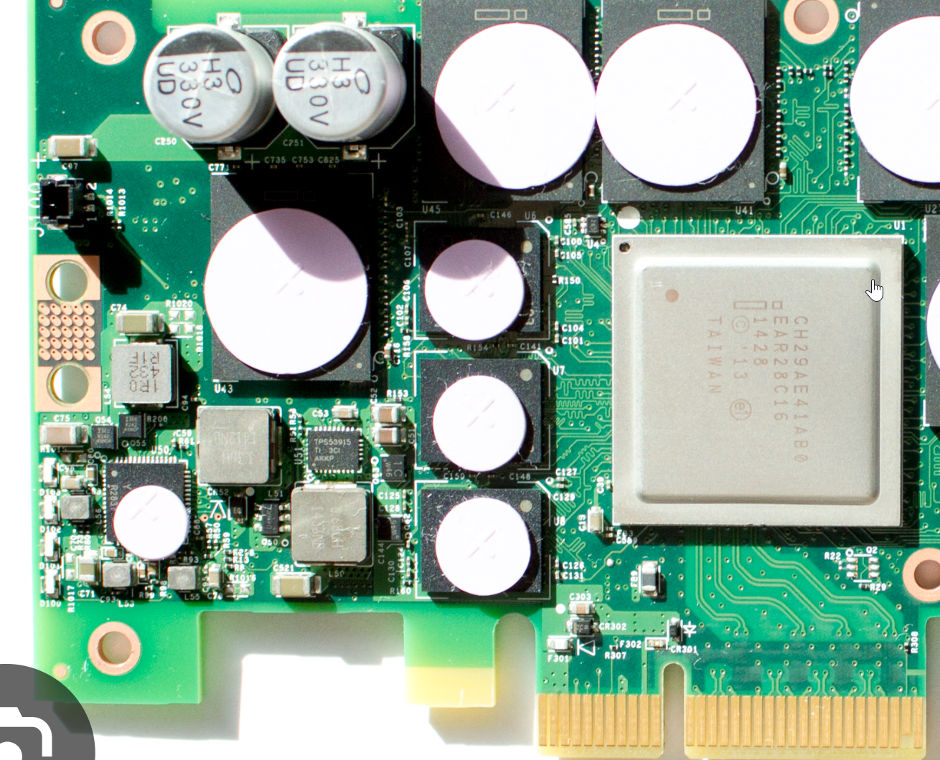
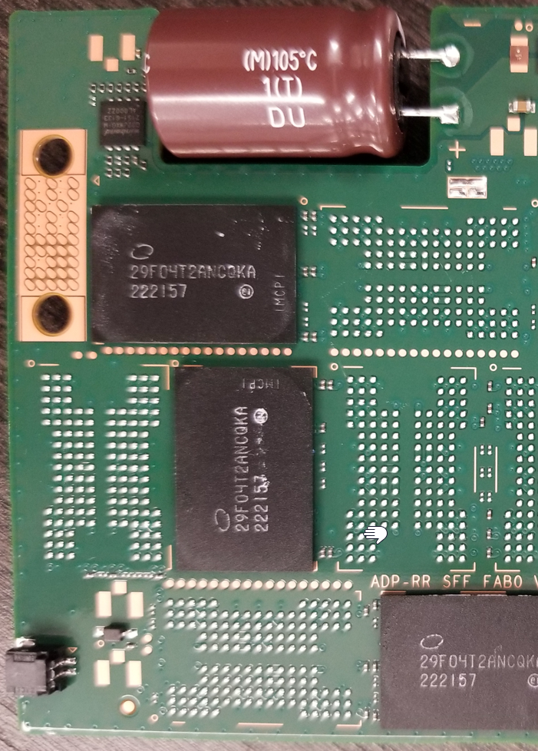
Exercise – Spot the difference(s)

Slide 53
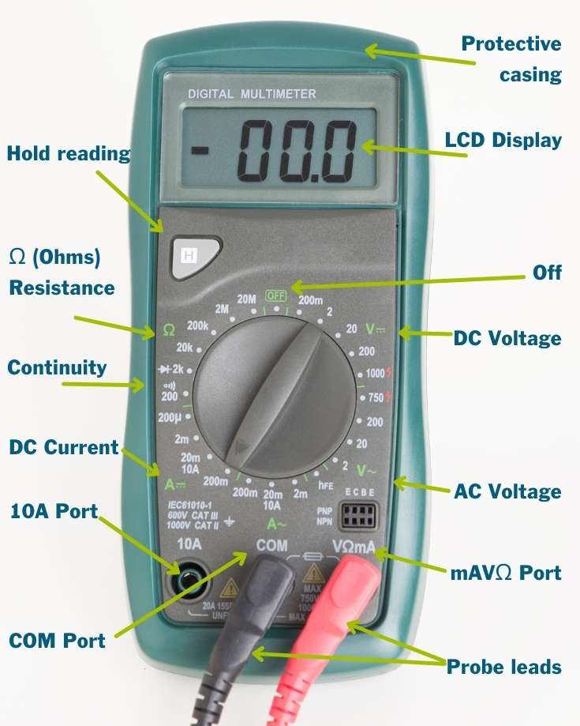
Basic Probing
Important Skills:
Checking pin voltages
GND & continuity testing
Determining logic-levels
Multimeter is often the 1st tool a hardware hacker will reach for…know how to use it!

Slide 54
Case Study: PCB

Slide 55
Quick Glance Time…
With our target device opened and the board exposed, what can we identify…?

Slide 56


Slide 57


Populated connectors
Unpopulated connectors
Unpopulated IC?
Removed/Option resistors?
(pull-up, open-drain, etc.)
Pins (mostly) labeled ☺

Slide 58
Chips & Datasheets

Slide 59


Chips– Looking Closer
Chip Markings
“Chip Number”
Manufacturer Name/Logo
Designators for lead content/plating finish
QR Codes (often)
Polarity Markings
Notch/Dot – Indicates Pin 1
Pin numbers increase moving CCW around the chip

Slide 60

Chip Numbers
Most chips have a 2-part serial number (i.e. “MC74HC00”)– typically the top marking
Company Prefix (MC=Motorola)
Chip type/specs (74HC00=Quad 2-input NAND)
Chips may have additional proprietary notations; for instance, small Micron chips have FBGA codes for lookup using their part decoder
Attackers will usually recognize manufacturer codes and logo’s (https://www.ultralibrarian.com/2020/09/15/list-of-ic-manufacturer-codes-ulc)

Slide 61


Chip Numbers– More Examples
Note that every manufacturer uses slightly different format/nomenclature, but with the same basic structure

Slide 62


Obtaining Datasheets
Resources
Datasheet Archives (alldatasheet.com, datasheets.com, etc.)
Full or Partial/Similar Number Search
Narrow by package, function, etc.
Electronics Distributors (Digi-Key, Mouser, Arrow, etc.)
Datasheets often provided on product pages

Slide 63
Datasheets – Brief Introduction
During initial teardown, the datasheet may help us to just identify the chip
When diving deeper, we’ll look for things such as:
External Interfaces
Pinouts
Signal/Bus Descriptions
Proprietary Command Sets
Latching/Timing Diagrams
Later in the course we’ll extract this information from the datasheet of a NAND flash chip and use it to build an improvised chip-reader

Slide 64
Case Study: Component Identification

Slide 65
Chip Number | Vendor | Function | Details/Datasheet
(...) | (...) | (...) | (..)
Look closer at the target board and try to identify any chip numbers you can
Keep your findings organized using a table like the one above
This part may take a bit; be resourceful
Google translate, new company names, etc.
Some chips (especially obsolete ones) will be hard/impossible to find..

Slide 66

(back side)

Slide 67
The following can be found using a few quick searches:
Chip Number | Vendor | Function | Details/Datasheet
WPCS7542E A1 | Cortina (now Inphi Corp.) | Controller | "Advanced Network Processor with 2xCPU; 3xGE; 6xTS; Crypto; 3xPCIe; 4xSATA; LCD;2xPCM; 800Mhz, 625 PIN BGA" https://www.arrow.com/en/products/wpcs7542e.a1-900306/inphi-corporation
K4B2G1646Q-BCK0 | Samsung | (x2) SDRAM | https://www.datasheets.com/en/part-details/k4b2g1646q-bck0-samsung-electronics-55374854#datasheet
S34ML04G100TFI003 | Spansion (now Cypress) | SLC NAND Flash | https://pdf1.alldatasheet.com/datasheet-pdf/view/464250/SPANSION/S34ML04G100TFI003.html
EM357 | Silicon Labs | Zigbee SoC | https://www.silabs.com/documents/public/data-sheets/EM35x.pdf
ZW0301 |  | Z-wave controller | https://www.keil.com/dd/chip/4478.htm
QCA8337-AL3C | Qualcomm Atheros | Ethernet Switch | https://github.com/Deoptim/atheros/blob/master/QCA8337-datasheet.pdf
QCA9880-BR4A | Qualcomm Atheros | WLAN SoC | https://www.qualcomm.com/products/internet-of-things/networking/wi-fi-networks/qca9880
AR9580-AR1A | Atheros (now Qualcomm Atheros) | WLAN SoC | -
ATMLH352 | Atmel (now Microchip) | Display controller | https://commons.wikimedia.org/wiki/File:Gigaset_DA810A_-_LCD_display_-_controller_-_Atmel_H3522EC-9644.jpg
APL5932A | Anpec | Linear Regulator | https://pdf1.alldatasheet.com/datasheet-pdf/view/1070998/ANPEC/APL5932A.html
(...) | (...) | (...) | (..)

Slide 68
Day 3

Slide 69
External Interfaces
UART

Slide 70

UART
Universal Asynchronous Receiver/Transmitter
Some context:
UART is NOT a “hardware protocol”– this is a common misnomer
A UART is a chip (or a circuit within a chip) used for serial communication
Various serial protocols can be transmitted via UART:
RS232
RS485
TTL (raw transistor voltage levels)
We will focus on TTL serial over UART as this is commonly used in embedded systems for short-link debugging interfaces

Slide 71

UART
Asynchronous communication means the communicating interfaces are not synchronized by a common clock; rather, Stop/Start signals are used to frame transmitted data
Most UART’s we will deal with are full duplex
This means they can talk/listen simultaneously
Some will have input disabled; output is still useful for information gathering

Slide 72

UART
For 2 UART’s to communicate, they must agree on the following:
Baud Rate
Parity bit
Data size
Stop bits size
Flow control
Common configuration: 8 data bits; no parity bit; 1 stop bit (“8-N-1”)
Most common Baud Rates: 9600, 57600, 115200 bps

Slide 73

UART
Note from the first block diagram that the UART receives a clock signal from an external system
As a mere receiver/transmitter, it also receives data (and logic-levels) from the controlling system
To communicate with this interface, we need our own UART; we’ll connect:
our receiver to their transmitter
our transmitter to their receiver

Slide 74



UART
To interface via UART using a test computer, will need a TTL Serial – USB adaptor
FTDI IC’s are typically used, though generics/copies exist
Most off-the-shelf serial tools are just an FTDI chip, or generic equivalent, on a breakout board (e.g. the Mini-Module)

Slide 75





UART
On our target PCB we likely won’t see the UART itself, we’ll see its pins ‘broken out’ in the form of pads, pins, through-holes, etc.
The interface/pins may or may not be labeled in silkscreen
Pins may be grouped or separate
Interface may be grouped w/others
If UART is exposed as 2 random test points, it may be
TRICKY to find!

Slide 76
UART
The interface typically includes 2-4 pins:
Tx – most important pin; this transmits the signal we’re interested in
Rx – combined w/Tx we have an interactive console (if present/enabled)
GND – we don’t need this; the PCB shares one common ground, so we can replace this with any grounded surface on the board including pins, shields, screws, etc.
Vcc – Reference voltage; we will NOT use this pin if present

Slide 77
UART - Exercise
Let us assume the interface shown is a UART
Using what we’ve learned about copper pads:
Can you immediately spot the GND pin?
How about the Vcc (power) pin?
Can verify by probing!
With 2 pins identified, that leaves Rx/Tx – we can determine which is which by trial and error using our receiver
Rx to Rx: nothing will happen
Rx to Tx: we should see data
Alternatively: find by probing!

Slide 78
UART
With pinout identified, we’re ready to attempt a connection
Serial adapters, when plugged in, should be visible from the test system:
Linux – ‘/dev/ttyUSB0’ for instance
Windows– serial COM port
Access using any serial communication program
i.e. screen, minicom, etc.
Using screen: “screen /path/to/adapter [baud rate]”
Example:

Slide 79

UART – Determining Baud Rate
Method 1: Measuring
Probe transmitter pin using oscilloscope or logic analyzer WHILE device is running
Record wavelength of captured signal
Baud Rate ≈ ⅟(wavelength / 2)
Example shown:
wavelength/2 ≈ 17.36us
1/wavelength ≈ 57600bps

Slide 80

UART – Determining Baud Rate
Method 2: Trial-and-Error
Try common baud rates and observe the output
Correct rate will yield readable ASCII output
Clock mismatch will result in mutilated output (pictured)
Many open-source tools exist to automate this for saving time
https://github.com/biw/Baudrate.py
https://github.com/sickcodes/python3-baudrate
https://github.com/devttys0/baudrate/blob/master/baudrate.py
Easy project– try writing your own script for Baud Rate Detection!

Slide 81

UART
If successful, we can interface directly with our embedded device
What we may find:
Console/shell access
Boot menu
Peripheral controls (e.g. SPI)
Filesystem
Verbose Chip/Storage specs
Plenty more…
In addition to the UART itself, what we find may assist with other attack vectors!

Slide 82
Case Study: UART

Slide 83

Using the methods discussed in this lesson, connect to the target device using the POPULATED header indicating UART (as shown)

Slide 84


Recall the lesson on baud rate detection…
If done correctly, the console should display the boot sequence

Slide 85


The console will spit out information very quickly
To capture for review, we can use the ‘screen’ commands logging feature
Now we can go back and mine our .txt file for useful tidbits
e.g. We can see right away this is the Cortina chip (main controller)
Note the JTAG ID for later!

Slide 86

If we hit enter when the device is operational, we can get a shell!
Unfortunately, it’s password protected…
Assuming we don’t know the password, there’s MUCH more we can do ☺
Note: this password hash is compiled via the CONFIG_AUTOBOOT_STOP_STR_SHA256</config> setting
Can we use an environment variable to override this??
(see U-Boot shell next)

Slide 87

Notice they left us access to the U-Boot shell
This is often mitigated using a boot delay
If so, this can be bypassed
U-boot is the hacker’s best friend
VERY dangerous for us to have this access

Slide 88


Take some time to explore all the different help menus, commands, etc.
Some are critical from attack perspective

Slide 89


Pay close attention to bootcmd and bootargs!
Can you follow the chain of variable names to understand what’s actually executing?
Note all the storage info, addresses, things that might help later…

Slide 90

Get creative – look for fail-opens, fuses, registers, connected peripherals/storage
Flash, EMMC, etc.
SPI, I2C, etc.
try holding the HW reset button and observe in the console
Some chip defenses account for SW-based reboots but not HW!
Can we dump flash for offline analysis?

Slide 91
External Interfaces
JTAG

Slide 92


JTAG
Joint Test Action Group
Some context:
Industry standard for verifying/testing manufactured PCB’s
Initially for boundary-scan testing (physical interconnects, faults) at board-level
80’s brought wider use of BGA’s, preventing access to signals
Limitations of bed-of-nails, flying probes, etc. became evident
Test fixtures increasingly complex/expensive
JTAG → test functionality built into IC
Implementation/uses continually evolve
Today JTAG may be used for:
Boundary-scanning
In-Circuit Testing
Processor debugging/emulation
Programming FPGAs/CPLDs
Storing firmware

Slide 93

JTAG
Joint Test Action Group
More context:
Most embedded systems have dedicated debug port for serial communication
Consumer devices
Most won’t explicitly provide JTAG connector…
May be leftover on board from prototyping/production
If present, may assist in RE or exploit development
We’ll focus on JTAG as means of MCU firmware extraction

Slide 94

JTAG
Every JTAG-enabled chip provides at least one TAP (Test Access Port)
Interface design allows multiple chips/TAPs daisy-chained together (like SPI)
Multiple chips can share single debug port on device
Chain of TAPs is called a scan chain

Slide 95

JTAG
Like SPI, implementations vary; logic signals are usually:
TDI – Test Data In
TDO – Test Data Out
TCK – Test Clock
TMS – Test Mode Select
TRST – Test Reset (Optional)
These signals control a finite state machine (within the TAP Controller) as seen on the next slide

Slide 96

JTAG
TMS is sampled on rising edge of TCK
Mode selects 1 of 2 “paths” (Instruction/Data Register)
Shift registers move data in/out using TDI/TDO

Slide 97
JTAG
JTAG requires at least 2 Data Registers (more are standardized):
Boundary Scan register– primary “data” register
BYPASS register – single-bit pass-through; connects TDI/TDO
JTAG requires at least 4 instructions to be implemented (vendors can add more, standardized or device-specific):
EXTEST – external boundary scan
SAMPLE/PRELOAD – boundary scan (during device operation)
BYPASS – “skip” boundary scan chain (we’ll use to test physical connection)
Most designs also implement the IDCODE instruction
IDCODE – output device identification stored in IDCODE register

Slide 98

JTAG
As stated JTAG is vendor/device-specific like SPI
Interface may be “wrapped” in middleware architecture
Abstracts TAP as well as connected interfaces (flash, ROM, CPU, etc.)
E.g. ARM chips use ARM’s CoreSight debug architecture
ARM Debug Interface (ADI): https://piolabs.com/blog/engineering/diving-into-arm-debug-access-port.html
“DAP” (Debug Access Port) used instead of TAP
Further granularity for different cores/architectures
Implemented for both JTAG and SWD (Serial Wire Debug, discussed later)
For ARM, we can import special library into OpenOCD (discussed later)

Slide 99

JTAG
Much like UART we’ll see its pins ‘broken out’ in the form of pads, pins, through-holes, etc.
The interface/pins may or may not be labeled in silkscreen
Pins may be grouped or separate
Interface may be grouped w/others
IF present, the interface may be disabled via hardware or firmware!
If disabled via hardware we may be able to replace missing pull-up/down resister, fix a severed trace, etc. to re-enable

Slide 100

JTAG
What if our JTAG port has unlabeled pins?

Slide 101

JTAG
If we know which pins may contain JTAG, we can discover the pinout by ‘brute force’:
Try every pin combination
Each attempt sends IDCODE instruction
Correct pinout will yield a valid IDCODE
Tools widely used to automate discovery:
JTAGulator (dedicated HW) – http://www.grandideastudio.com/jtagulator/
Raspi (open-source scripts) – https://github.com/cyphunk/JTAGenum
Note: always probe for GND, logic-level first!

Slide 102

JTAG
What if we don’t HAVE a port…but the interface IS somewhere?

Slide 103
JTAG
Finding the interface itself can be tricky (sometimes on purpose ☹)
We may have to deduce its location by:
Chip proximity
Traces
Datasheet (if chip known)
Pin count/grouping (can we spot 5+ pins that look related?)
Probing!!!
Do we know the target’s logic level (recall earlier lesson)?
WILL NEED THIS anyway before interfacing safely
E.g. SSD controller’s typically use 1.8V for JTAG…see next slide

Slide 104

JTAG
The previous image showed an opened SSD (solid-state hard drive)
To locate the controller’s JTAG interface, UL:
Noted a line of 7-8 pins near the target controller
Checked for voltages ≤ 1.8v, located GND
Brute-force remaining pins

Slide 105

JTAG
An example with grouped, plated through-holes:

Slide 106

JTAG
Manufacturers often use proprietary connectors/fixtures to prevent easy access
How do we locate JTAG in this fine-pitched array of 38 ‘candidate’ pads?

Slide 107


JTAG
By creating our own bed-of-nails test fixture … remember, creativity is the limit!

Slide 108

JTAG
Pads are broken-out to standard header size (.1”) for easy jumper-access
Brute-forcing 24 pins at once, we can locate JTAG in 2 quick scans ☺
Advanced hardware hacking often requires making your own tools/connectors…

Slide 109

JTAG
Now that we know the pins, we’ll connect using an on-chip debugger
Standard tool is OpenOCD (https://openocd.org/)
Supports most common chips/cores/etc. (up-to-date)
JTAG & SWD
Import libraries for proprietary middleware (i.e. ARM’s CoreSight)
Local/remote debugging via Telnet+GDB
Countless supported dongles
Dedicated JTAG Adapters (e.g. Segger J-Link)
Expensive, with hit-or-miss results
Adaptors only compatible with certain chipsets
FT2232 (or equivalent)-based Adapters
Mini-Module, Bus Pirate, Shikra, etc.
Recall FTDI chips from UART lesson?
Used for UART, SPI, JTAG, SWD, I2C, and more…
Hardware hacker’s “Swiss army knife”!
Serial IC’s are VERY cheap & dispensible

Slide 110

JTAG - OpenOCD
Running on Linux: “openocd –f [int.cfg] –f [target.cfg]”
Interface (adapter) configuration file
Preinstalled .cfg files for all compatible boards
Some tools provide their own (e.g. Xipiter’s Shikra)
Target configuration file
Preinstalled .cfg files for many common chipsets
May be available on manufacturer’s site
No config file?
If we know the chip, we can build it ourselves from the chip’s datasheet
If not, we can try “autoprobing”

Slide 111
JTAG - OpenOCD
Autoprobing
With no target configured, OpenOCD can automatically check the scan chain for enabled TAPs (note: modern processors may have TAP for each core!)
For all TAPs identified, output will provide further configuration code
May STILL need more information to configure out debugger…
If we can identify CPU cores, developer pages can help us map the chip’s memory
https://developer.arm.com/documentation/dui0552/a/the-cortex-m3-processor/memory-model

Slide 112


JTAG - OpenOCD
Looking at the connected ROM table tells us this TAP uses the CoreSight architecture mentioned previously
As we’ve learned, OpenOCD provides a config file containing the libraries needed for ARM’s interface
Using ‘DAP’ commands, we must halt the CPU – then we can debug, dump firmware, etc. ☺

Slide 113


JTAG – Level-Shifting
Note: When interfacing via JTAG, ALWAYS mind your levels!
Before you connect anything, determine your target’s required logic-level via probing/datasheet
Common levels: 1.8V, 3.3V, 5V – depends on target device
Most adapters are 3.3v; if the target is 1.8v, you’ll FRY the target chip
Some tools (e.g. JTAGulator) use built-in level shifters
With most adapters you’ll need your own level shifter
Choosing the best shifter for any project:
(Great Resource!)

Slide 114



JTAG – Level-Shifting
Keep the “magic smoke” inside the chip! (https://en.wikipedia.org/wiki/Magic_smoke)
Always have a backup device – hardware hacking means bricking things

Slide 115
Case Study: JTAG

Slide 116


Note the unlabeled 10-pin connector near the Zigbee controller
As we’ll learn later, the OTHER 10-pin connector has labels indicating an SPI bus
Tracings/proximity hint this is related to the nearby SoC; perhaps it's for the main controller (broken out for ease-of-use)
Given the number of pins, there’s a chance this connector hosts a JTAG debug port
Connect a JTAGulator (or equivalent) to these pins to find out
A cheap debug cable (shown) can help break out the pins
Much easier and more robust than small clips, etc.

Slide 117


Slide 118


Note that we are using 3.3v logic levels
As we learned, this should be checked first with probing
If connected properly, you should see the output shown using a JTAGulator
Pins #’s will differ based on how you are connected
Note: being an ARM CPU (as we’ll see shortly), it’s likely this connector also contains a Serial Wire Debug port which we’ll study briefly later
TDO TDI TCK
GND TMS TRST#

Slide 119


With pins known, connect using an OpenOCD-compatible adapter
Ex. Bus pirate (shown)

Slide 120

Try using the Autoprobing feature mentioned earlier
https://openocd.org/doc/html/TAP-Declaration.html
You’ll need the config file for your specific adapter
If connected properly, we should see the same IDCODE’s we found when we determined the pinout
Note the vendor info and # of TAPS

Slide 121

We COULD use the output we received to write our own config files
However, if you check the available target list you may notice something awfully convenient (good thing we recorded everything earlier)
Let’s try running this readymade config file for ‘em357’ and see if it works…

Slide 122

It worked, and we’ve identified the ARM processor in use!
Check the ARM developer site for memory map, etc. ☺

Slide 123
Explore the ARM debug interface we studied earlier; we now have full access to this CPU
If we halt the chip, we can step instructions, read/write to memory, or create whole firmware dumps
Check core info for where code is stored
If unsure…dump, test in disassembler, and dump again (trial-and-error) to obtain full images

Slide 124

Strings immediately verify we’ve dumped from the EM357
It appears this debug port is for Zigbee!
Also note: we DO NOT see the IDCODE for the Cortina chip we noted from the boot log (we know main chip is not on this scan chain)

Slide 125


Note: make sure you import using correct processor/language type if you’ll be reverse-engineering your dump!

Slide 126
Day 4

Slide 127
External Interfaces
SPI

Slide 128
SPI
Serial Peripheral Interface
Some context:
‘De facto’ standard for short-distance wired communication between chips in embedded devices (again – NOT a “hardware protocol”!)
SPI is a synchronous serial interface– and unlike UART, SPI does not refer to a chip; the term may refer to:
Chip’s physical interface
Bus
Specification
Used by controllers to interface w/peripherals, such as:
Sensors
Displays
Memory
Attackers primarily interested in accessing flash/EEPROM via SPI

Slide 129

SPI
Master-Slave architecture
Master controls communication, provides clocking
Chip Select allows for “daisy chaining” multiple peripherals
Communication is usually full duplex with four logic signals:
SCLK – serial clock
MOSI – master out, slave in
MISO – master in, slave out
CS/SS – chip/slave select (depending on configuration)
Naming conventions vary! More examples:
Master/Slave = Main/Sub
SCLK = SCK = SCL = CLK
CE = Chip Enable

Slide 130

SPI – Chaining Configurations

Slide 131

SPI
As stated, the SPI bus is a ‘de facto’ standard – NOT a protocol
Every device defines its own “protocol”
Duplexity, commands (if supported), signals, word size, active H/L, etc. all vary
Hardware & connectors also device-specific
Using a specific SPI will require obtaining datasheet using methods discussed earlier

Slide 132


SPI – Chip-On vs. Chip-Off
Chip-On
As with UART, we may find SPI in some form of breakout or connector on the board
Pins may be labeled; if not, we can determine pinout by:
Tracing pins to chip legs (remember our multimeter skills?)
Looking at chip’s datasheet for pin descriptions
Without a port/header we’ll need to connect directly to the chip…

Slide 133


SPI – Chip-On vs. Chip-Off
Chip-On
Test Clamp (“Chip-clip”)
Not available for all packages (recall TSOP48 from previous lesson?)
Not always a secure connection
Test Clips
Fasten to individual pins
Small-pitch clips get very pricey ☹
Contacts bend/break easily
Micro-soldering to pins
Creativity is the limit…

Slide 134


SPI – Chip-On vs. Chip-Off
Chip-On
Chip-On interaction prevents us from having to remove the chip, rendering device inoperative
Removed chip may take extreme care/effort to reattach
Why remove a chip for interaction?
No clamp/clips available
Difficult pitch
Chip has no legs (remember some of package types we saw: BGA, QFN, etc.)

Slide 135



SPI – Chip-On vs. Chip-Off
Chip-Off
Chip usually placed in socket
Must match chip’s package
Best to keep sockets for common flash types
Socket connects to chip-reader (”programmer”/”flasher”)
Commercial (“Universal”) Programmer
Pro’s
Built-in socket or connector
Comes with GUI software
Easy, no knowledge required
SPI details automated/abstracted
Con’s
Expensive
May ignore proprietary commands
Only recognizes supported chips – if our chip isn’t supported, we’re on our own!

Slide 136

SPI – Chip-On vs. Chip-Off
Chip-Off
Open-source CLI tools, i.e. “flashrom”
Pro’s
Use our own hardware
Simple terminal commands
No knowledge required (aside from chip name)
SPI details automated/abstracted
Con’s
Only recognizes supported chips – if our chip isn’t supported, we’re on our own!
Write our own software
Pro’s
Use our own hardware
Improve our understanding
Not limited by “supported chips” or compatibility
Con’s
Must have datasheet available
Requires some low-level coding

Slide 137

SPI – Chip-On vs. Chip-Off
(Quick Note: we can use our own software for Chip-On extraction as well…)

Slide 138




SPI – Chip-On vs. Chip-Off
Chip-Off
One more Chip-Off method worth mentioning is called “dead-bugging”
This entails soldering to the pins of a removed chip
Name after the obvious resemblance shown
Easy with certain package types (brave hackers have done this to complex BGA’s!)
Means of physical connection; can be used with paid, open-source, or custom software

Slide 139

SPI – Chip-On vs. Chip-Off
Chip-Off
Again, creativity is the limit… and sometimes patience

Slide 140
Case Study: SPI

Slide 141


Recall the debug port near the Zigbee controller
It appears the SPI connector on the board is for the Z-wave controller
To obtain main device FW via SPI we’ll need to remove the flash chip found earlier
Before building a chip reader, let’s go through a quick example
Similar model from Securifi → Almond 3
https://www.securifi.com/rg/almond3
Flash datasheet: https://www.digikey.co.th/htmldatasheets/production/1952774/0/0/1/n25q512a.html
We’ll see how datasheet instructs us to:
Connect pins
R/W via bit-banging
Example command: Read ID
Outputs manufacturer info

Slide 142



Find the pin diagram on that datasheet
This tells us how to connect with a microcontroller

Slide 143


Find the timing diagram for the READ ID command
The code for implementing this command from an Arduino/Redboard is shown on the right
Note how latching and I/O is done by simply driving digital pins HIGH/LOW
Datasheet also has specific diagrams for command latching, address latching, and data
All delays/times are documented as well

Slide 144

When run from a terminal using ‘screen’, we receive the output expected based on the datasheet
Reading ID is a perfect ‘test command’ to ensure the chip-reader is working
Typically the easiest/quickest to write and test
If working, THEN move to reading firmware (which may take some time)
Now, try developing the same type of chip reader for the Almond+ using the datasheet we found earlier from Spansion

Slide 145


First step is to carefully remove the chip using a heat gun and place in a TSOP48 (– DIP48) socket
(If possible, soaking removed chip in isopropyl alcohol briefly will clean oxide layer to prevent shorts in socket)

Slide 146

Referring to the Spansion datasheet, determine which pins are needed and how we’ll need to use them
Recall what we learned about SPI and how details vary b/w vendor implementations
Pins are slightly different than the Micron chip
More signals needed

Slide 147


When ready to connect, make sure you understand how the chip socket breaks out the IC pins...

Slide 148


This is what proper connection looks like using a microcontroller
May look neater than this…
Use breadboard if big enough
M-F jumpers very helpful

Slide 149


Once connected, find the Read ID command
Study timing/latching diagrams, I/O bytes, etc.
As in the example before, try converting this command to bit-banging code
Begin w/pseudo code
Decompose systematically into easy algorithms
Ex. sending command:
Enable chip/CL
WE low
[output command]
WE high
Disable CL

Slide 150

Run using ‘screen’ in terminal to test your code
If done correctly, will output the bytes indicated in the datasheet (shown right)
After Read ID try implementing other commands
E.g. ‘Page Read’ command (try iterating through all pages)
Often more than 1 way to pull the entire firmware; try finding the most ‘elegant’ (or fastest) way…
If unsuccessful → don’t worry! We will obtain firmware through other means!

Slide 151
External Interfaces
Other Common Standards

Slide 152


ISP/ICSP
In-System Programming / In-Circuit Serial Programming
Programming/updates after IC installation
Most MCU manufacturers implement their own variant
Ex. Atmel, AVR, Microchip
Integrate coding/testing (save $$$/time)
Serial int. requires less real estate on PCB than specialized connector
No need to buy pre-programmed from distributor
Vendor provides specialized programmer/debugger
Ex. Microchip’s PIC
MPLAB ICD
PICkit

Slide 153



ISP/ICSP
PIC on this IoT router – what does it do??
Dump in MPLAB IDE
RE time…
Flavor = Intel
Language = PIC16F

Slide 154

ISP/ICSP
PIC on this IoT router – what does it do??
‘Reset’ function
Interrupt handling routines
Read Peripheral Interface reg.
Read Synchronous Serial Port reg.
Should have made use of PIC’s configuration fuses to prevent readout!

Slide 155


I2C
Inter-Integrated Circuit
Short-distance serial communication bus; connects controller to low-speed peripherals
Used for low cost & simplicity
Less overhead than UART
Fewer pins than SPI
Design
Clock (SCL) and Data (SDA) lines
Bi-directional, Master/slave architecture (chainable)
Protocol/messages on bus are device-specific

Slide 156

SWD
Serial Wire Debug
Essentially a modified version of JTAG for ARM processors
Same protocols using only 2 pins
SWDIO (data)
SWCLK (clock)
May share JTAG pins (dual-mode programmers)
TMS → SWDIO
TCK → SWCLK

Slide 157
Day 5

Slide 158
Case Study: Firmware Update

Slide 159


If FW was not obtained from the device itself, we can grab an update from the Securifi support page (https://www.securifi.com/rg/support)
Follow link under Software
Select ALMOND+ for Step 2
Select ‘Download’ under Step 4

Slide 160

A quick peek at this download reveals the following:
U-boot wrapped image
uImage header
zImage (compressed Linux kernel)
Archive (gzip)
Squashfs filesystem (lzma)

Slide 161



Digging further:
U-boot wrapped image
uImage header
zImage (compressed Linux kernel)
Archive (gzip)
Archive (cpio) – special char files
Archive (lzo) – linux config file
Squashfs filesystem (lzma)
Try carving different ‘pieces’ with ‘dd’ tool
Other things: strings, checksums, DER certs, etc.

Slide 162
We’re most interested in the filesystem
As this is a downloaded update, we won’t find user data/secrets (can still find default passwords, etc.)
We CAN find product-wide vulnerabilities/bugs
Investigate:
System binaries
Shell scripts
Config files
Lots of proprietary code!
Any info assisting further attacks
Network interfaces especially interesting
Check SW behind ‘newer’ libraries/protocols
i.e. Zigbee/Z-wave

Slide 163
Case Study: Threat Modeling

Slide 164


Slide 165
Recall typical architecture studied earlier
Let’s revisit our board now that we understand the chips & interfaces…

Slide 166
HW Reset
Debug – Zigbee controller
SPI – NAND flash
(back side)
UART – Zigbee controller(?)
Serial USB
UART – Main IC
SPI – Z-Wave controller
UART – Z-Wave controller(?)
HW Reset

Slide 167

WLAN Controller 1
Z-Wave Controller
Zigbee Controller
WLAN Controller 2
USB
Ethernet Switch
Main Controller
LCD
What sort of damage can be done considering our large attack surface?
Consider all device functions explored…
Don’t forget connected devices/networks
Ethernet/Wi-Fi
Connected IoT devices
How can we impact these from our vulnerable device?
How can we attack the device from each network?
What sort of data enters/leaves each route?
Flash
SDRAM

Slide 168

In addition to the main chip, we’ve determined we can obtain FW (and possibly console/boot/debugging access) for 2 other controllers (which are likely ‘sensitive’)!
Review the various threats/impacts around each device
Fuses, drivers, libraries, encryption, privileges, etc.
Combine understanding of all HW & SW investigated; build a “treasure map” of attack routes
Consider access (local, remote; privileged, unprivileged; etc.)
To complete our case study, try putting together a threat model for the Securifi Almond+

Slide 169

Remember key areas to focus on in a time-bound assessment
Although we’ve focused on the hardware, keep in mind there is MORE to this attack surface
Web application
Mobile application (Android/iOS)
Wireless communication
Ideal penetration test will encompass these as they are inherently connected
We’ll NEED compatible smart devices for thorough testing…

Slide 170


Slide 171
Conclusion

Slide 172
Concepts covered:
State of HW Security
Device Teardown
PCB Analysis
Component/Datasheet Lookup
Integrated Circuits
External Interfaces
Boot Security (U-boot)
On-Chip Debugging
Datasheet Analysis
Firmware Extraction/Analysis
Threat Modeling

Slide 173


Further learning/practice:
Write a script for baud rate detection
Build a more advanced chip reader
Sends multiple commands
CLI arguments
Practice different vendors/packages
Try the UNPOPULATED UARTS we didn’t explore
Extract FW
Find bugs in SoC’s
Can you attack serial USB?
Investigate all SoC's
Reverse-engineer Securifi binaries
Search known vulnerabilities
Lots of OLD chips/libraries
Old version of U-boot (MUST be a gold mine)
Find device w/other buses and protocols to investigate
e.g., I2C, SWD, CAN
Assess any new device you can get your hands on… hardware skills come with LOTS OF PRACTICE!!!

